Slide 1

Diseases in Livestock
What’s most important number to know????

Slide 2
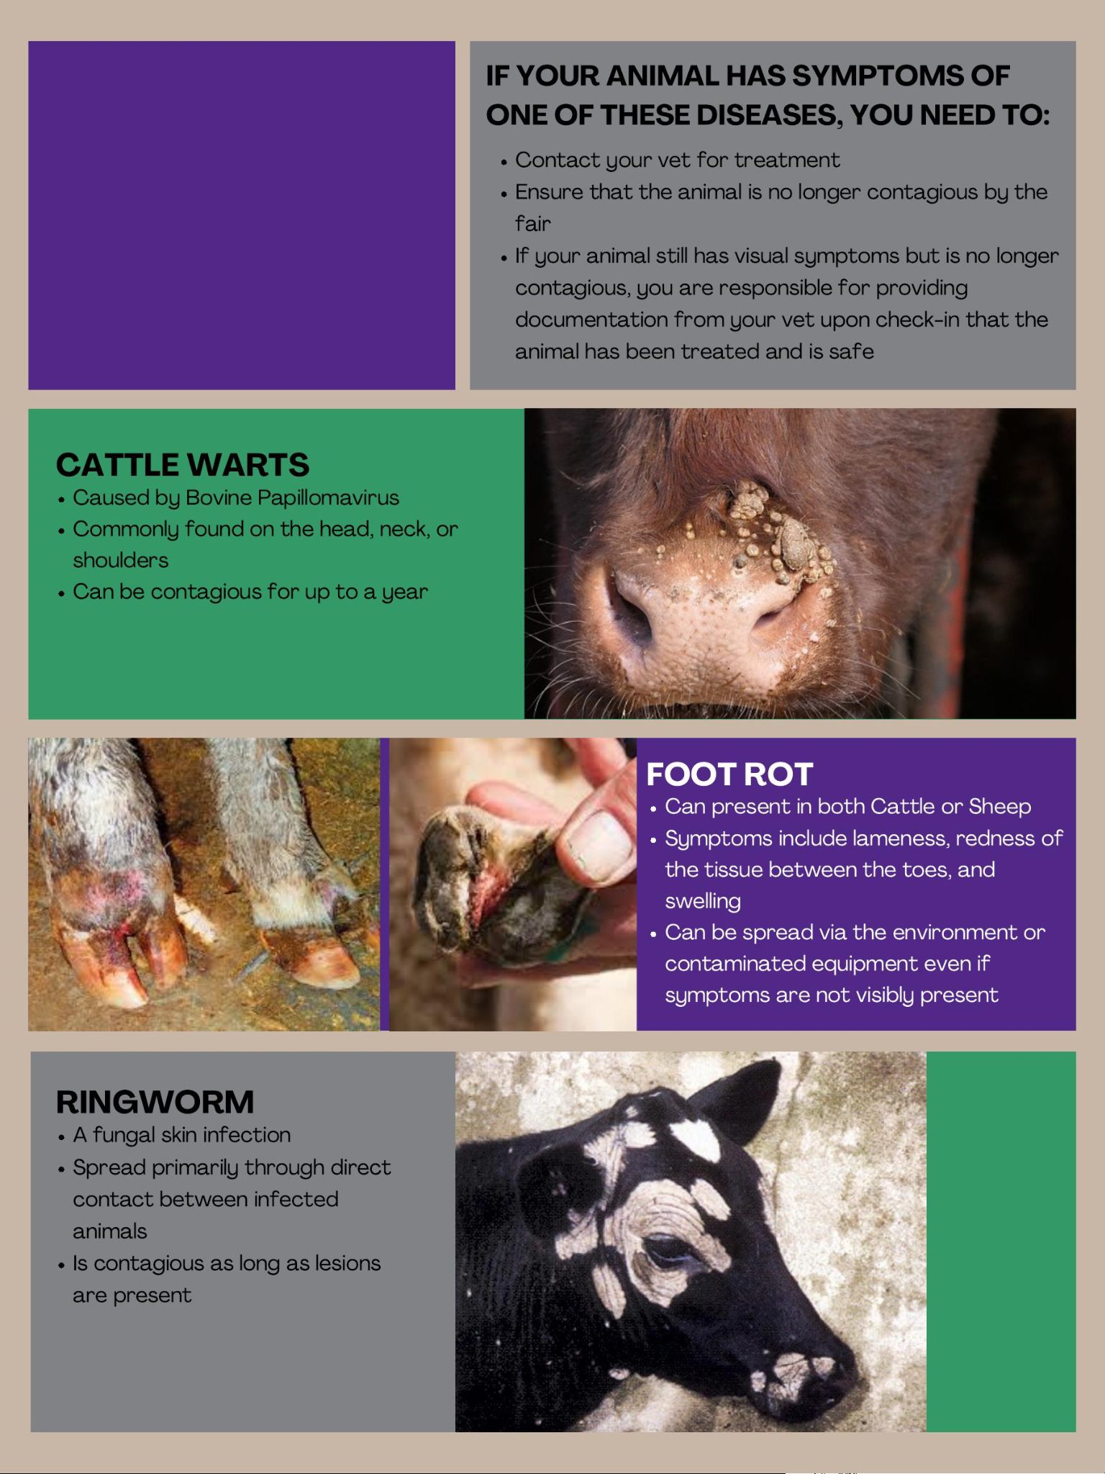

Slide 3
Why is this disease important???

Slide 5
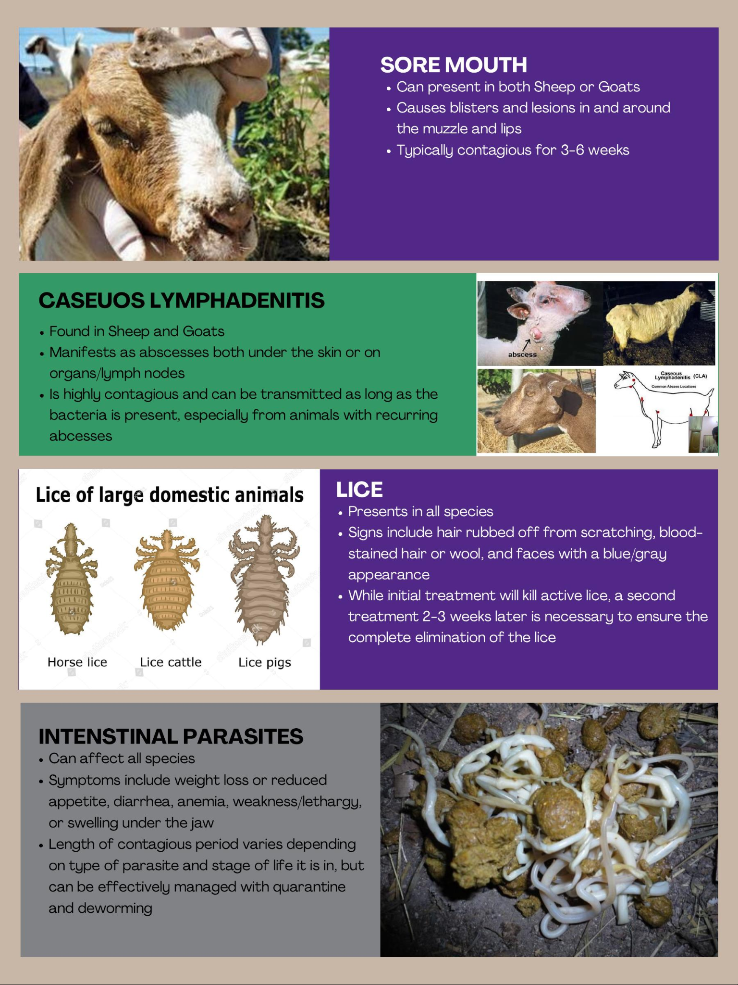

Slide 7
Which of these is zoonotic???

Slide 8
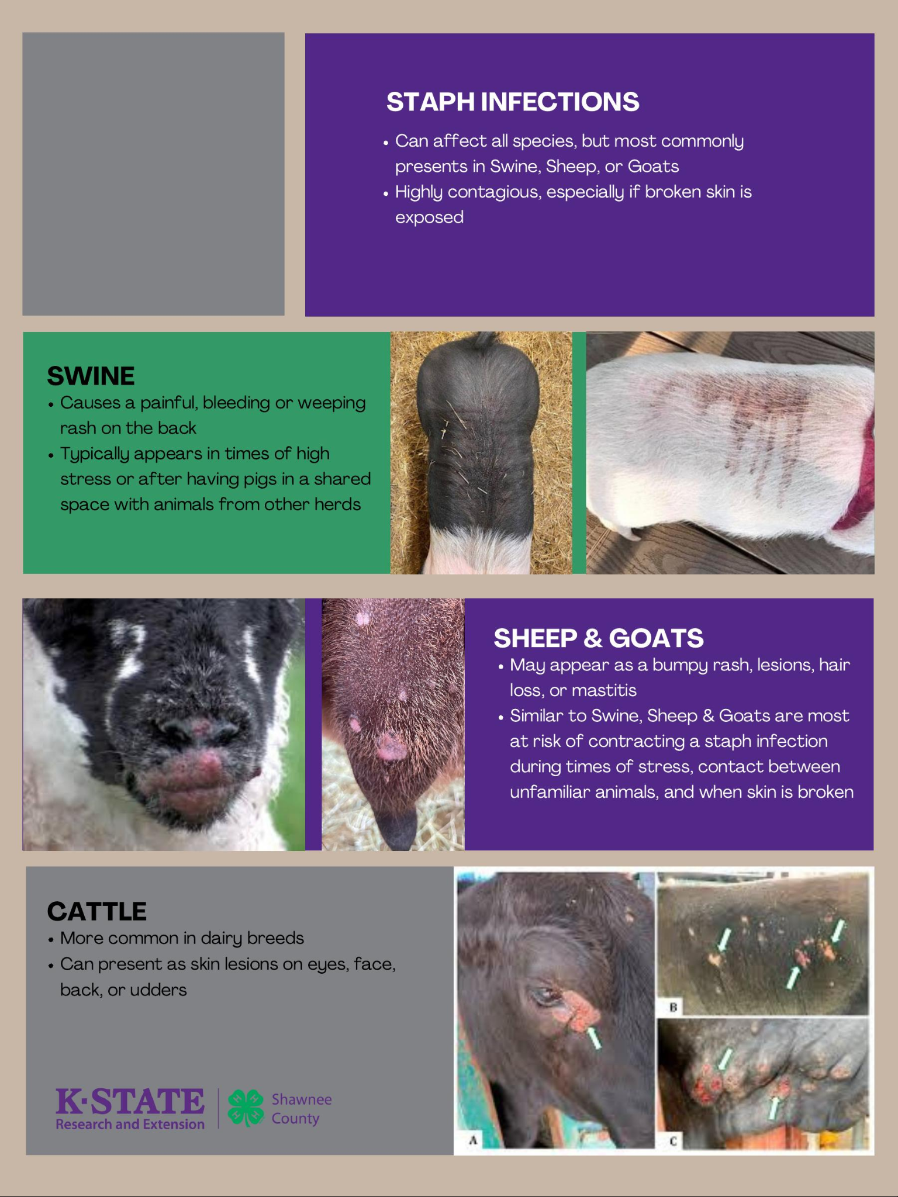

Slide 9
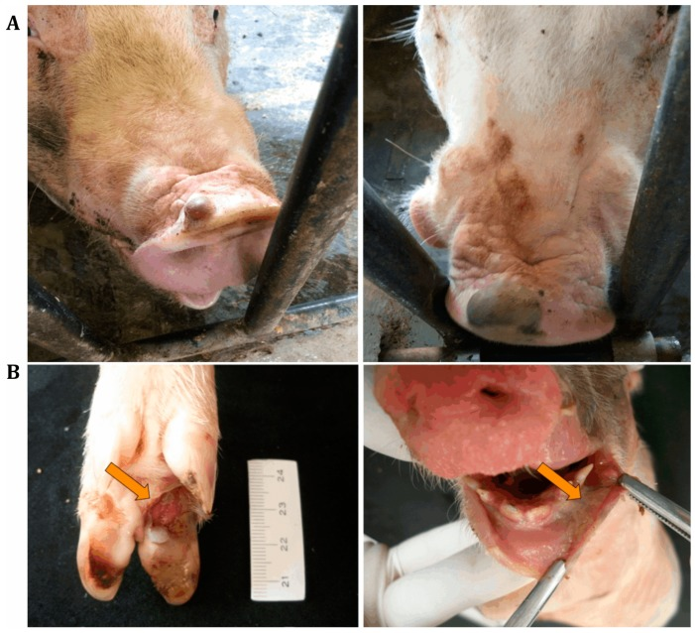

Slide 10
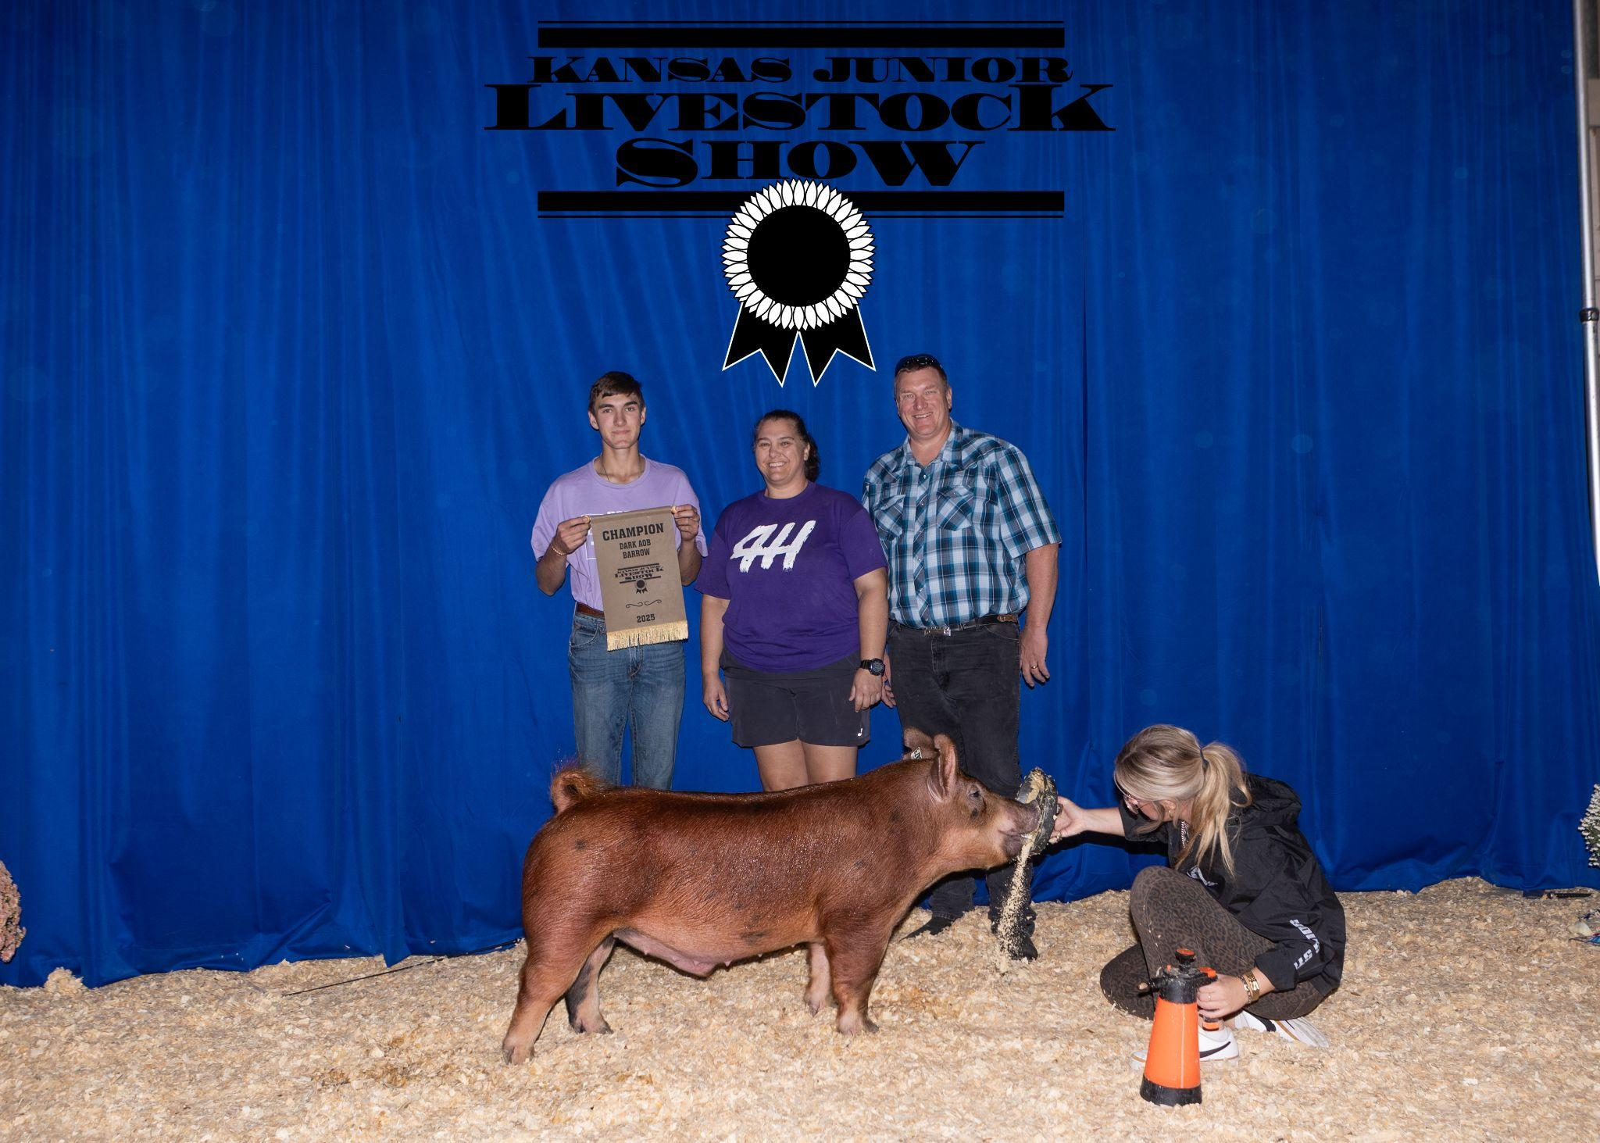
Questions

